Slide 1

A Project Report On “E-VOTING SYSTEM BASED ON BLOCKCHAIN” Presented by
SUBHAM SUBHAKANTA ROUT (190106LE10)
Under the guidance of
Mr. Arupananda Sahoo (Supervisor)
DEPARTMENT OF COMPUTER SCIENCE & ENGINEERING
GIET UNIVERSITY, GUNUPUR-765022
2023

Slide 2



Slide 3


Slide 4
AGENDA
Election E-Voting
Blockchain Voting System
System Requirement
Flow Chart
Result
Conclusion
References

Slide 5
Election E-Voting
Elections are fundamental pillar of a democratic system enabling the general public to express their views in the form of a vote. Due to their significance to our society, the election process should be transparent and reliable so as to ensure participants of its credibility. Within this context, the approach to voting has been an ever evolving domain. This evolution is primarily driven by the efforts to make the system secure, verifiable and transparent.
During voting, the person to be elected is the candidate of an election, and the person who casts a ballot for their chosen candidate is voter . Usually, the voter can vote in accordance with the list of candidate or vote for any other persons he/her prefers.

Slide 6
Blockchain Voting System
Blockchain technology provides a platform for creating a highly secure, decentralized, anonymized, yet auditable chain of record, used presently in cryptocurrency systems
This same technology could also be used to record and report votes and prevent many types of voter fraud in elections.

Slide 7
System Requirements
Laptop / PC
Processor: Dual-Core processor, 1.8 GHz
Memory: 512MB of RAM (1GB recommended)
Internet
Remix IDE
Metamask
Ganache

Slide 8
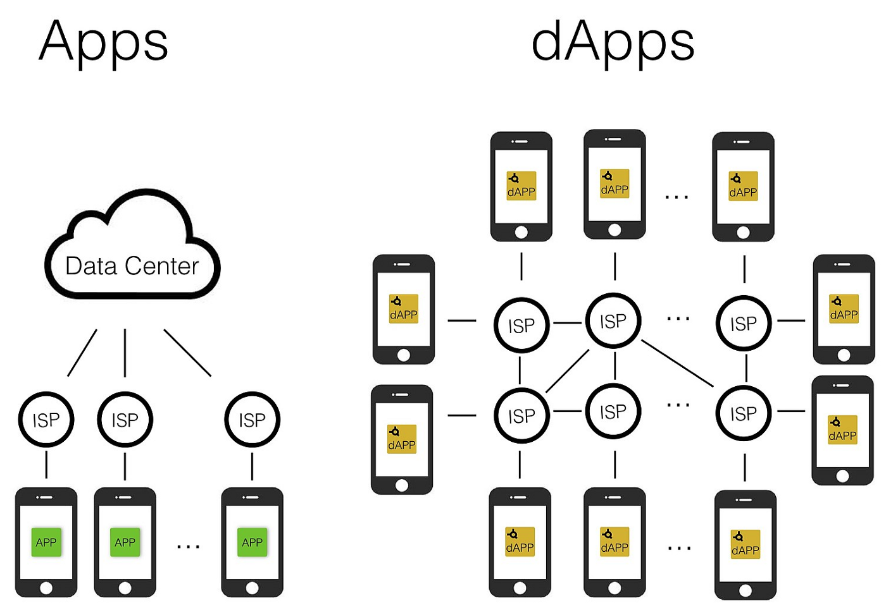

Slide 9


Slide 10


Slide 11


Slide 12

REMIX IDE

Slide 13
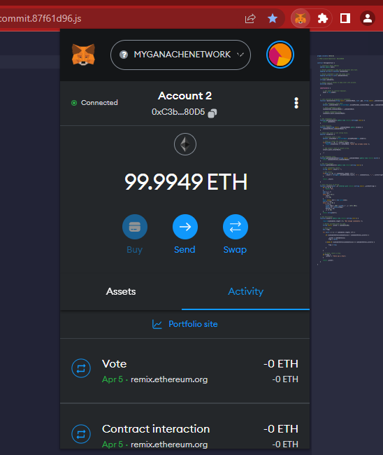
METAMASK WALLET

Slide 14
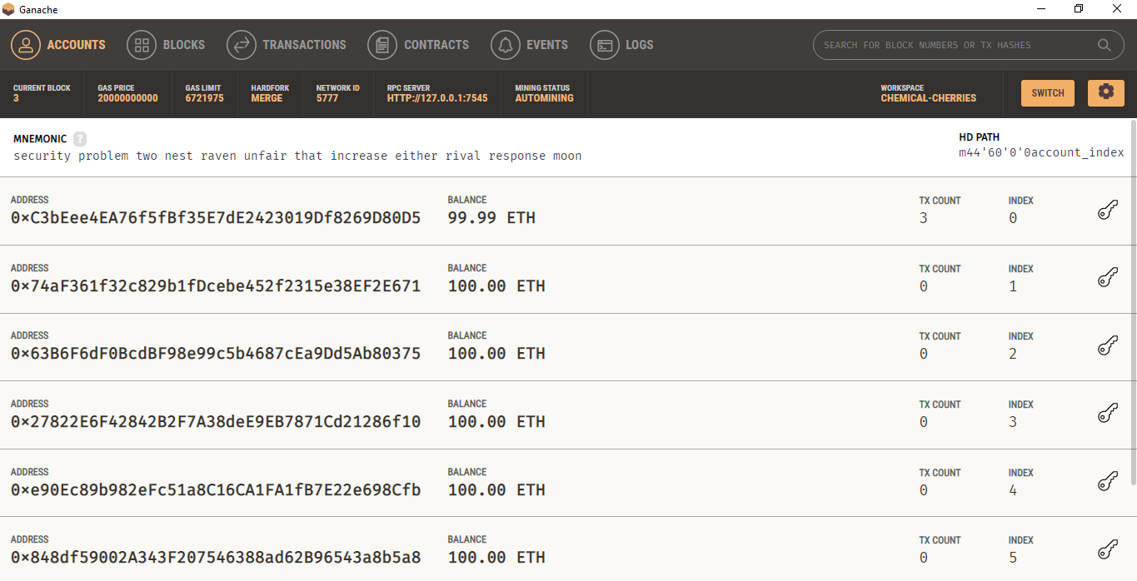
GANACHE

Slide 15
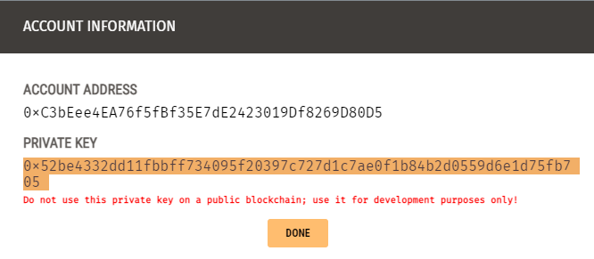
GANACHE ACCOUT INFO (Address & Private Key)

Slide 16
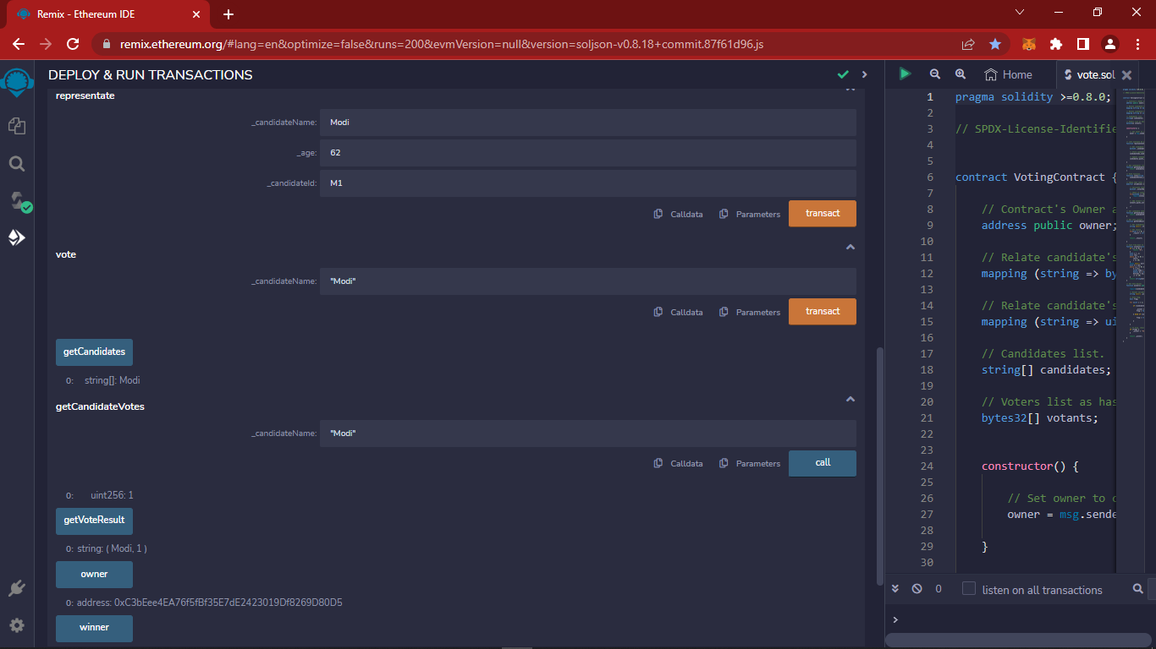
DURING DEPLOYEE & RUN TRANSACTION

Slide 17
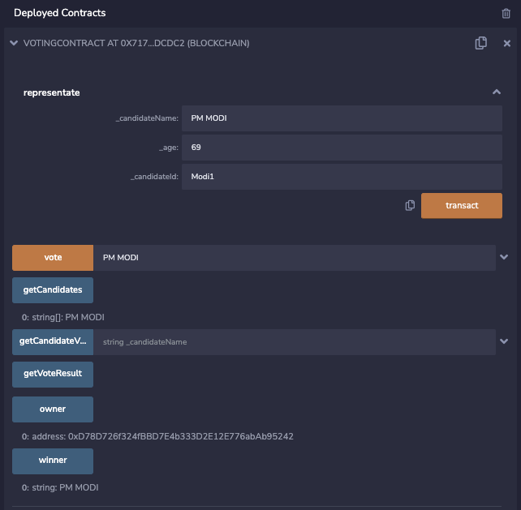
OUTPUT VOTING SCREEN

Slide 18
CONCLUSION
The proposed e-voting system is based on the Blockchain technology. Any registered voter will have the ability to vote using any device connected to the Internet. The Blockchain based system will be secure, reliable, anonymous and will help increase the number of voters as well as the trust of people in their governments. The current existing system has large number of issues. Hence, it is vital to have a transparent voting system that must have the least number of obstacles. Considering all these factors, the proposed system is a comprehensive solution that satisfies all the requirements.

Slide 19
REFERENCES
[1]. Nir Kshetri and Jeffrey Voas, “Blockchain-Enabled E-Voting”, in IEEE Software, DOI: 10.1109/MS.2018.2801546, JULY/AUGUST 2018
[2]. Fridrik .P. Hjalmarsson, Gunnlaugur .K. Hreidarsson, “Blockchain-Based E-Voting System”, in School of Computer Science Reykjavik University, Iceland, JUNE 2018
[3]. Ahmed Ben Ayed, “A Conceptual Secure Blockchain- Based Electronic Voting System”, in International Journal of Network Security & Its Applications (IJNSA) Vol.9, No.3, MAY 2017
[4]. Freya Sheer Hardwick, Apostolos Gioulis, Raja Naeem Akram, and Konstantinos Markantonakis, “E-Voting with Blockchain: An E-Voting Protocol with Decentralisation and Voter Privacy”, in ISG-SCC, Royal Holloway, University of London, Egham, United Kingdom, JULY 2018
[5]. Gaby G. Dagher, Praneeth Babu Marella, Matea Milojkovic and Jordan Mohler, “BroncoVote: Secure Voting System using Ethereum’s Blockchain”, DOI: 10.5220/0006609700960107, in Proceedings of the 4th International Conference on Information Systems Security and Privacy, pages 96-107, ISBN: 978-989-758-282-0, 2018

Slide 20



